Slide 1
NCYM, Inc.
2019 Annual Meeting
November 2, 2019
Don Farlow, Presiding Clerk, welcomed everyone to the NCYM, Inc. Annual Meeting and called on NCYM, Inc. Board member Judy Ritter for the opening devotional.

Slide 2
Opening Minute/Devotional Judy Ritter NCYM, Inc. Board

Slide 3
Following devotions Don reviewed the
Structure for
NCYM, Inc.
(as approved by NCYM Friends
in Annual Session August 5, 2017;
Effective January 1, 2018)

Slide 4
NCYM, Inc. [an integrated auxiliary of two associations of meetings (churches)]
The NCYM, Inc. Board is comprised of six members each from North Carolina Fellowship of Friends and Friends Church of North Carolina. NCYM, Inc. exists to support the ministries and missions of Friends in North Carolina through these two associations of meetings (churches) and the subsidiaries and committees of NCYM, Inc.

Slide 5
FCNC
F&P authority
Nom. Comm.
F&P Rev.
Comm. on Clerks
Exec. Comm.
M&C
…
FCNC Askings
As of 12/31/18
NCFF
F&P authority
Nom. Comm.
F&P Rev.
Comm. on Clerks
Exec. Comm.
M&C
…
NCFF Askings
NCYM Inc.
MOWA-Choctaw Center
Cemeteries
QLC Land/Buildings
Real Estate/Proceeds (“Funds”)
Financial & Admin Services
24.4% available TF income
75.6% available TF income
NCYM Funds, LLC
TF income
NC FDS, LLC
NCYM/QLC Pledge (75.6%)
NCYM/QLC Pledge
(24.4%)
Quaker Lake Camp, LLC
Operating Agreement
Lease Agreement
Board-Managed Camp
“Structured to maintain current (2017) mission”
QLC Foundation
Funding

Slide 6
Responsibilities of NCYM, Inc.
Oversight of Quaker Lake Camp, LLC Operating and Lease Agreements (ownership of land/buildings)
Oversight of NCYM Funds, LLC Operating Agreement and distribution of Funds income
Oversight of trust fund income expenditure by FCNC and NCFF in compliance with covenants/donor wishes (defining/refining process)
Establish future structure for:
Friends Disaster Service; now an LLC
MOWA Choctaw Friends Center; incorporated independently as “The Friends Center, Inc.”
Friends Cemetery Committee (Cemeteries owned/under the care of NCYM, Inc.)
Conclude sale of former Spring Garden Meeting and NCYM office properties (through incumbent Trustees) and investment of proceeds as undesignated trust funds via NCYM Funds, LLC (SGFM completed)
Conduct Annual Meeting with mutual reporting by all entities, including NCFF and FCNC (conducting NCYM, Inc. Second Annual Meeting)

Slide 7
NCYM, Inc. Board 2018 - 2022
Bill Davis
Ken Hill
Quinn Jordan
Frank Massey
Carolyn McPherson
Carl Semmler
David Briles
Don Farlow
Mary Anna McCullen
Judy Ritter
Kevin Smitherman
Gwen Taylor
Initial Board – Approved in 2017 NCYM Annual Sessions for a five-year term

Slide 8
2018 & 2019 NCYM, Inc. Board Officers
Clerk – Don Farlow
Assistant Clerk – Carl Semmler
Recording Clerk – Carolyn McPherson
Assistant Recording Clerk – Judy Ritter
Treasurer – Gwen Taylor
Assistant Treasurer – Quinn Jordan
Officers for 2020 will be determined in the January 2020 Board meeting.

Slide 9
NCYM Pension Plan Buyout Costs
Don then reviewed costs related to the reorganization of NCYM, summarized as “Transition Costs.”
Retiree Funding Costs ------------------ $5,272,386.66
Stanley Benefits (actuarial costs) ---- $ 25,150.00
Total Retiree Plan Costs ---- $5,297,536.66
Total Available Retirement Funds -- $5,290,972.91
Underfunded Buyout Costs --- $ 6,563.75

Slide 10
2017-2018 NCYM/NCYM, Inc. Transition Costs (thru 12/31/18)
Underfunded Buyout Costs ----------------------------------- $ 6,563.75
Expert Costs (legal) ---------------------------------------------- $107,725.77
SGFM 2018 Costs (ins., maint., util., …) -------------------- $ 16,408.78
Total Transition Costs* -------------------- $ 130,698.30

Slide 11
2017-2019 NCYM/NCYM, Inc. Transition Costs thru 9/30/19
Underfunded Buyout Costs -------------------------------------- $ 6,563.75
Expert Costs (legal) ------------------------------------------------- $112,568.27
2018 SGFM and 2019 ”Hilltop” Costs (ins., maint., util.) -- $ 30,272.44
Total Transition Costs* ------------------------ $ 149,404.46
2019 year-to-date costs include legal fees primarily related to the MOWA Choctaw Friends Center property and establishment of the Quaker Lake Camp Foundation and costs associated with the former Yearly Meeting office on Hilltop Road.

Slide 12
NCYM/NCYM, Inc. Transition Costs
*Paid from the NCYM/NCYM, Inc. Operating Account. A transition fund was approved in June 3, 2017 Rep Body and August 5, 2017 Annual Session, should funds be required beyond the Operating Account. This transition fund includes funds from the former Church Extension Loan Fund and, as necessary, drawing from the proceeds of the sale of the real estate. When the transition is complete, the balance of these funds will function as an undesignated trust fund, with the income benefiting the Associations.

Slide 13
Those present approved of accepting the report of NCYM, Inc. Board Clerk, Don Farlow, as presented.

Slide 14
NCYM, Inc. Unified Audit and Financial Review Gwen Taylor NCYM, Inc. Treasurer

Slide 15
NCYM, Inc. Unified Audit 2018 Fiscal Year
NCYM, Inc. Fiscal Year – January 1 through December 31, 2018
NCYM Funds, LLC Fiscal Year – April 1, 2018 through December 31, 2018 (to make fiscal years consistent)
QLC, FDS, NCFF and FCNC Fiscal Year – January 1 through December 31, 2018
2018 Unified Audit includes all entities except NCYM Funds, LLC
Audits conducted by the same certified public accountants/auditing firm.

Slide 16
Auditor’s Opinion NCYM, Inc. 2018 Fiscal Year Unified* Audit
“In our opinion, the financial statements referred to above present fairly, in all material aspects, the assets, liabilities, and net assets arising from cash transactions of North Carolina Yearly Meeting of Friends, Inc. for the year ended December 31, 2018, and the related statement of changes in net assets and fund balances for the year then ended ….”
Councilman, Farlow, Marlowe and Company
Certified Public Accountants and Advisors
*Unified audit includes NCYM, Inc. and all related entities except NCYM Funds, LLC.
“A ‘clean’ audit ….”

Slide 17
2018 NCYM, Inc. Unified Audit Review
Recommendation 1 (only item). “One employee should open the mail, make a control list of all receipts, and restrictively endorse all items received as ‘for deposit only.’ … The control list should be maintained separately from the individual who processes and deposits the checks.”
“Someone who does not otherwise handle receipts should compare the deposit to the control list of receipts to ensure that all funds on the receipts were deposited.”

Slide 18
2018 NCYM, Inc. Unified Audit Review
Response: As you know, NCYM, Inc. has only one employee, the Financial Manager. However, there is a “second set of eyes” that reviews/has the opportunity to review all transactions:
The same firm auditing all the entities related to NCYM, Inc. assures consistency of trust fund income receipt and dispersal.
With the other primary source of funding being “Askings” from the Associations’ member meetings, income is reported on a monthly basis via the Treasurer’s report, making any unusual activity in this area quite visible.
The treasurers of the respective entities (except NC FDS) have the opportunity to access their respective bank accounts online to review transactions.
The Quaker Lake Camp Director and the Financial Manager reconcile all of the Camp accounts on a regular basis.

Slide 19
2018 NCYM, Inc. Unified Audit Review
Response (cont.):
The NCYM Funds, LLC Treasurer and the Financial Manager reconcile trust fund account activity on a regular basis.
The Treasurers/Assistant Treasurers of NCYM, Inc. and its related entities (except NC FDS) sign their respective checks.
Dispersal of NC FDS funds requires the approval of two of the three co-coordinators, with checks signed by the NCYM, Inc. Treasurer.

Slide 20
2018 NCYM, Inc. Budgeted Expenses*
*Approved in NCYM Representative Body 6/3/17 with instruction to add cost of Financial Manager office rental in lieu of utilizing QLC.
Budgeted Expenses after Reorganization
Financial Manager’s Salary/Benefits -------$65,023
Office Expense -----------------------------------$10,000
Audit -----------------------------------------------$10,000
Office Rent ----------------------------------------$12,000
Contingency --------------------------------------$ 1,977
Total Budgeted NCYM, Inc. Expenses ---- $99,000

Slide 21
2018 NCYM, Inc. Budgeted Income*
Allocation of Expenses
Entity | Allocated Fee | %-age
FCNC (receive approx. 75.6% of TF income) | $33,680 | 34.0%
NCFF (receive approx. 24.4% of TF income) | $10,870 | 11.0%
Quaker Lake Camp | $24,750 | 25.0%
Friends Disaster Service | $ 4,950 | 5.0%
MOWA-Choctaw | $ 4,950 | 5.0%
Trustees of Trust Funds (NCYM Inc.) | $19,800 | 20.0%
Total | $99,000 | 100.0%

Slide 22
2018 NCYM, Inc. Budget Performance
Income: $99,000.00
Expenses: $103,423.64
Available Operating Account Balance 12/31/18: $128,799.46
Factors:
Hilltop not sold (utilities - $7.3K; insurance -$5.3K)
Copier lease ($4.8K/year thru 10/2020; did not go to QLC)
2017 audit above budget (~$3.5K due to transition)
Transition expenses reflected in the transition account, but all paid from the Operating Account

Slide 23
Those present approved of accepting the report regarding the NCYM, Inc. unified audit and the NCYM, Inc. financial review by the NCYM, Inc. Board Treasurer, Gwen Taylor, as presented.

Slide 24
NCYM, Inc. Real Estate Update Ken Hill NCYM, Inc. Board

Slide 25
NCYM, Inc. Real Estate Update
Spring Garden Property (Settlement Statement*)
Initial Sales Price ------------ $875,000
Asbestos Abatement ----- <$ 5,500> (~25% of total)
Brokerage Fee (4%) ------- <$ 34,780> (normally 6%)
Attorney Fees* ------------- <$ 1,000> (heavily discounted)
Tax Stamps ----------------- <$ 1,739>
Record Affidavit ---------- <$ 30>
Net Proceeds --------- $831,951
*Closed October 26, 2018

Slide 26
NCYM, Inc. Real Estate Update
Hilltop Property
Remains unsold (initial asking price - $350K/$325/now $299K …)
Additional flexibility indicated to broker
Announced Hilltop railroad bridge construction 2021-2024
Rezone and rent/lease (to own)
Address deferred maintenance (office roof installed January ’19; currently holding on additional work)
No written offer and only one verbal offer of $225,000 received since the property was listed.

Slide 27
Those present approved of accepting the report regarding NCYM, Inc. real estate by NCYM, Inc. Board member, Ken Hill, as presented.

Slide 28
Dr. J. R. Williams Grant Refunds Christian Vocations Loan Repayments Mary Anna McCullen NCYM, Inc. Board

Slide 29
Dr. J. R. Williams Grant Refunds Cumulative 12/31/18
Total due from meetings that withdrew ------ $326,504.60
Total committed to be repaid -------------------- $247,654.60 (75.9%)
Total received ---------------------------------------- $181,121.31 (55.5%)
Three meetings have not responded to requests
to repay (Union Cross, East Bend, Oak Hill).
Pine Hill has indicated they do not intend to repay.
Total ---------------------------------------------------- $ 78,850.00 (24.1%)

Slide 30
Dr. J. R. Williams Grant Refunds Cumulative 10/31/19
Total due from meetings that withdrew ------ $337,584.60
Total committed to be repaid -------------------- $258,734.60 (76.6%)
Total received ---------------------------------------- $207,768.01 (61.5%)
Three meetings have not responded to requests
to repay (Union Cross, East Bend, Oak Hill).
Pine Hill has indicated they do not intend to repay.
Total ---------------------------------------------------- $ 78,850.00 (23.4%)
Note that Westfield withdrew in March 2019 and refunded their Dr. J. R. Williams grants (reflected in cumulative totals year-to-date).

Slide 31
Dr. J. R. Williams Grant Refunds
These funds continue to fulfill the purpose of the original bequest to “enable the Monthly and Preparative Meetings of North Carolina Yearly Meeting of Friends [through its successor organizations] to carry on their ministries of worship, education and fellowship.”

Slide 32
Christian Vocations Loan Repayments 12/31/18
Two loan recipients are regularly repaying their loan.
Two loan recipients continue to repay through service.
Seven recipients have outstanding loans but no longer serve FCNC/NCFF.
Five have acknowledged their debt with a responsibility to repay (two of these have begun repayment in 2019).
One denies owing since NCYM “no longer exists.”
One graduated in May 2018 (served as campus pastor at Friends Campus Ministry–Raleigh fall semester 2018).

Slide 33
Christian Vocations Loan Repayments 12/31/18
For the seven loan recipients not serving and not repaying Christian Vocation Loans:
Total Due ----------$33,500
Total “Acknowledged” --------$27,500
Total Received as of 12/31/18 ------ $0

Slide 34
Christian Vocations Loan Repayments 9/30/19
For the seven five loan recipients not serving and not repaying Christian Vocation Loans:
Total Due ----------$20,750
Total “Acknowledged” --------$14,750
Total Received (from two now repaying) ------ $1,000
(these two owe a total of $12,750)

Slide 35
Those present approved of accepting the report regarding the refunding of Dr. J. R. Williams grants and the repayment of Christian Vocations loans by NCYM, Inc. Board member, Mary Anna McCullen, as presented.

Slide 36
MOWA Choctaw Friends Center Don Farlow NCYM, Inc. Board

Slide 37
MOWA-Choctaw Friends Center 2018 Annual Meeting Transfer of Property and Program
Absence of Association commitment to leadership and financial support under new structure
Absence of funding for on-site management (Director)
Absence of funding for deferred maintenance
Consideration of liability without on-site management and repairs to the Center
Consideration of the ACFIA intent to return the center to local control
Consideration of how the original mission/vision/ purpose of the Center can be accomplished in the future

Slide 38
MOWA-Choctaw Friends Center Subsequent to 2018 Annual Meeting
Representatives of NCYM, Inc. met with MOWA staff, local community and MOWA Choctaw Tribal Council in November 2018.
Resulted in a proposal from four local churches to establish a 501(c)(3) non-profit to operate the Center as “The Friends Center” (acknowledging the founding Friends)
After listening to the Tribal Council and “The Friends Center” representative, and weighing the initial mission of the Center, the respective focuses of the two groups, and receipt of The Friends Center, Inc. proposal, proforma budget and IRS 501(c)(3) Letter of Declaration, the NCYM, Inc. Board determined that “The Friends Center” provided the alternative most consistent with the founding purpose of MOWA Choctaw Friends Center.

Slide 39
MOWA-Choctaw Friends Center Subsequent to 2018 Annual Meeting
Our attorney prepared an agreement that was signed August 13, 2019, agreeing to transfer the property and some initial funding from MOWA Choctaw Friends Center funds held by NCYM, Inc. to “The Friends Center, Inc.”
“The Friends Center” welcomes our continued presence at the Center for special programming (summer VBS, sports camps, etc.)
“The Friends Center” committed to: “educate the public (especially the Choctaw descendants) of the value of their personal heritage and teach them to respect the heritage of others; advocate integrity in the administration of Indian affairs and all public affairs, and bear testimony to the Christian faith and its practice”

Slide 40
MOWA-Choctaw Friends Center Subsequent to 2018 Annual Meeting
In this time of transition, “The Friends Center” can certainly utilize our continued support for both deferred maintenance and programming.
The Center is working with a local women-at-risk program, utilizing the Quaker Lodge as a shelter with resident leadership.
The after-school program has been temporarily suspended as one of the ladies operating the program received full disability and the other two resigned. The Friends Center anticipates restoring the after-school program as the resources are available.
And there is a strong desire to see the Vacation Bible School and sports camp programs led by Friends meetings from North Carolina continue.

Slide 41
MOWA-Choctaw Friends Center 2018 Fiscal Year
Income: $61,796.57 (including a one-time bequest of $14,000 and $14,630 from the MOWA Choctaw Investment Account)
Expenses: $62,652.83
Salaries/SS - $29,568.51
Utilities - $13,256.13
Facility/Liability Ins. - $6,503.84
Financial Management - $4,950.00
HVAC repairs - $2,585.83
Computer equipment - $3,257.01
Miscellaneous - $2,531.51
Operating Account Balance 12/31/18 - $610.65

Slide 42
MOWA-Choctaw Friends Center
Investment Account Balance 9/30/19 - $35,644.58
Operating Account Balance 9/30/19 ----- $1,816.80
A question was raised regarding the sale or gift of a portion of the MOWA property to a former staff member. It was noted that this situation had been reviewed with the President of The Friends Center, Inc. and that it would be problematic for this new 501(c)(3) to take such an action and retain its 501(c)(3) status.

Slide 43
2018 North Carolina MOWA Choctaw Friends Center Audit Review The 2018 MOWA Choctaw Friends Center audit is incorporated within the NCYM, Inc. portion of the unified audit.

Slide 44
FCNC
F&P authority
Nom. Comm.
F&P Rev.
Comm. on Clerks
Exec. Comm.
M&C
…
FCNC Askings
As of 9/30/19
NCFF
F&P authority
Nom. Comm.
F&P Rev.
Comm. on Clerks
Exec. Comm.
M&C
…
NCFF Askings
NCYM Inc.
MOWA-Choctaw Center
Cemeteries
QLC Land/Buildings
Real Estate/Proceeds (“Funds”)
Financial & Admin Services
24.4% available TF income
75.6% available TF income
NCYM Funds, LLC
TF income
NC FDS, LLC
NCYM/QLC Pledge (75.6%)
NCYM/QLC Pledge
(24.4%)
Quaker Lake Camp, LLC
Operating Agreement
Lease Agreement
Board-Managed Camp
“Structured to maintain current (2017) mission”
QLC Foundation
Funding

Slide 45
Those present approved of accepting the report regarding MOWA Choctaw Friends Center by NCYM, Inc. Board Clerk, Don Farlow, as presented.

Slide 46
Cemeteries Owned/Under the Care of NCYM, Inc. (formerly the NCYM Cemetery Committee) Kevin Smitherman NCYM, Inc. Board Kevin was unable to be present and Don Farlow presented the report.

Slide 47
Cemeteries Owned/Under the Care of NCYM, Inc. (formerly the NCYM Cemetery Committee) Purpose
Provide care for Friends cemeteries which are no longer connected to an active Friends meeting in North Carolina Yearly Meeting (FUM) --- (NCFF or FCNC).

Slide 48
Cemeteries Owned/Under the Care of NCYM, Inc. 2018 Fiscal Year
Income: $7,361.35 (including a specific donation for repairs at Hollowell-Massey)
Expenses: $8,610.54 (including repairs referenced above following “Florence” and liability insurance)

Slide 49
Cemeteries Owned/Under the Care of NCYM, Inc.
Operating Account Balance 12/31/18 - $2,002.49
Trust Fund Account Balance 6/30/2019 - $179,622.72
Operating Account Balance 9/30/19 - $5,006.69

Slide 50
Forbush Friends (Kevin Smitherman, Brian Wooten, and others) at Dutchman’s Creek Friends Cemetery in Davie County October 6, 2018.

Slide 51
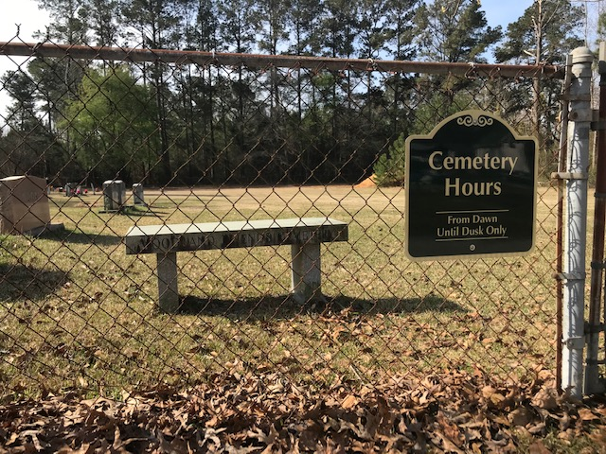
At the direction of our insurer, “Cemetery Hours” signs were placed at the cemeteries owned by NCYM, Inc. *
*Exceptions were permitted for cemeteries that such signage might invite amateur “archeologists.”
Sign in place at Woodland Friends Meeting Cemetery (meeting laid down).

Slide 52
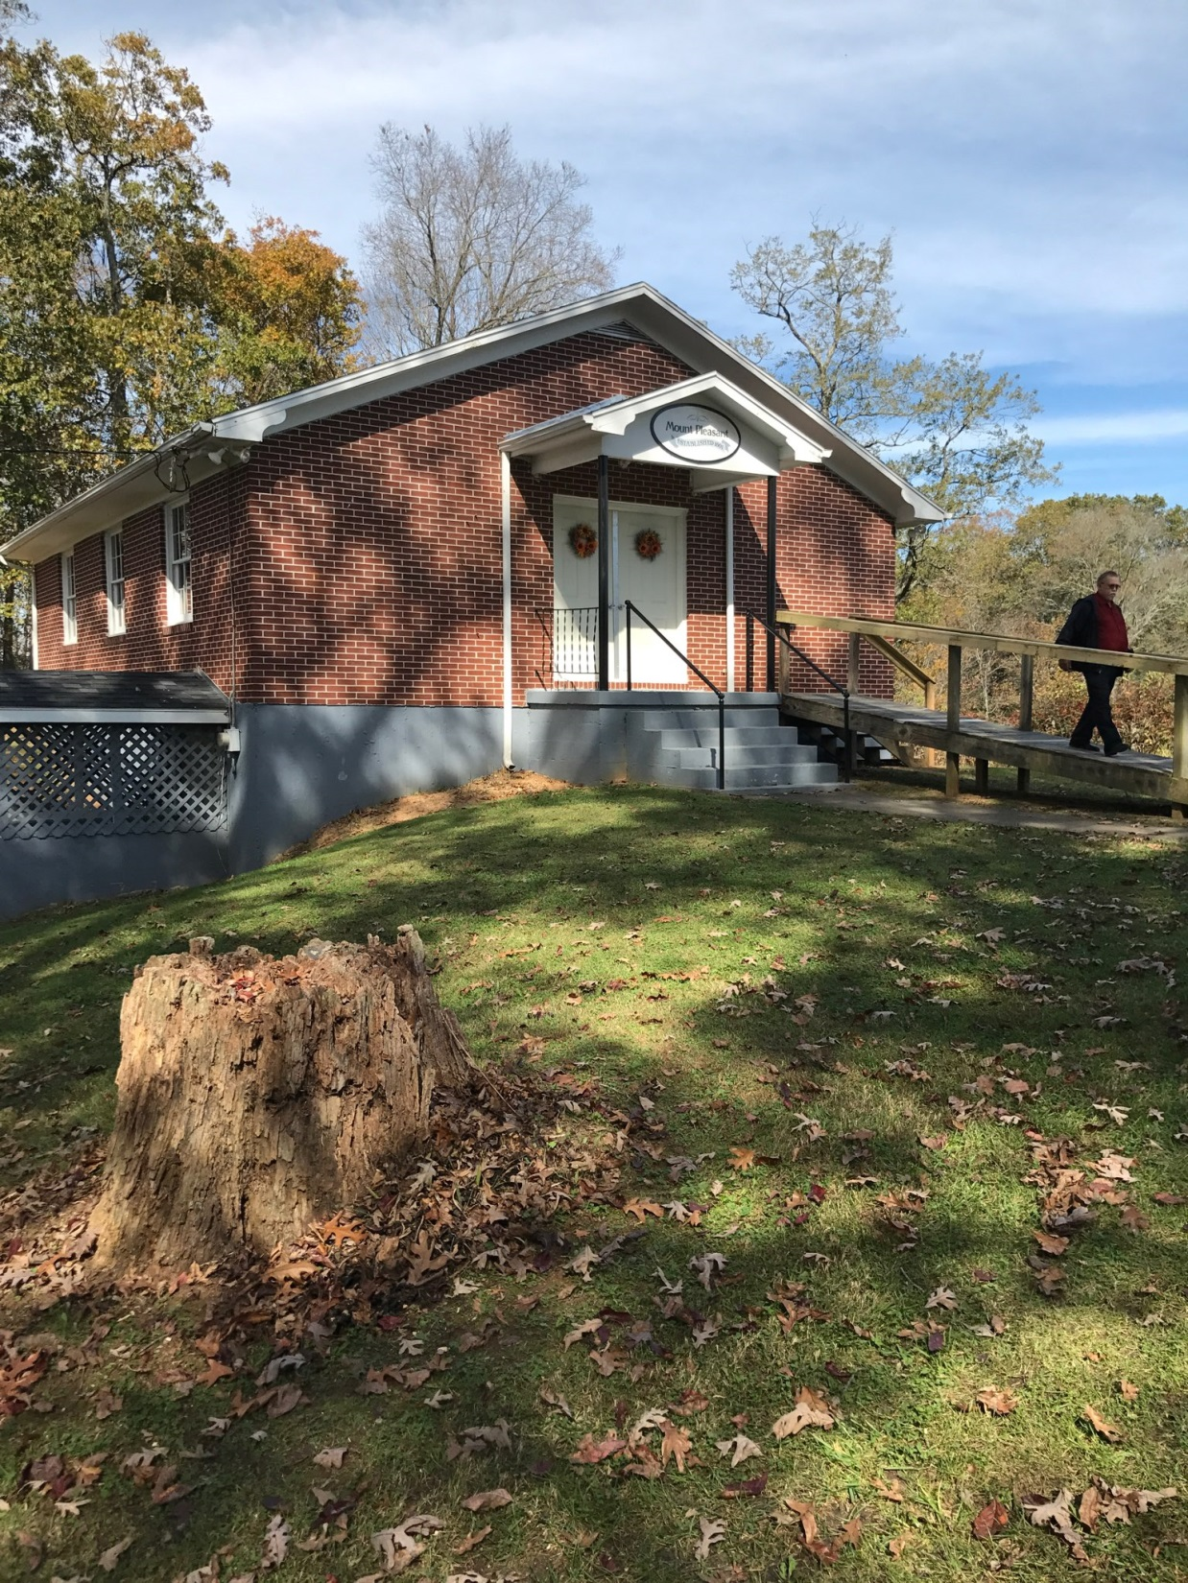
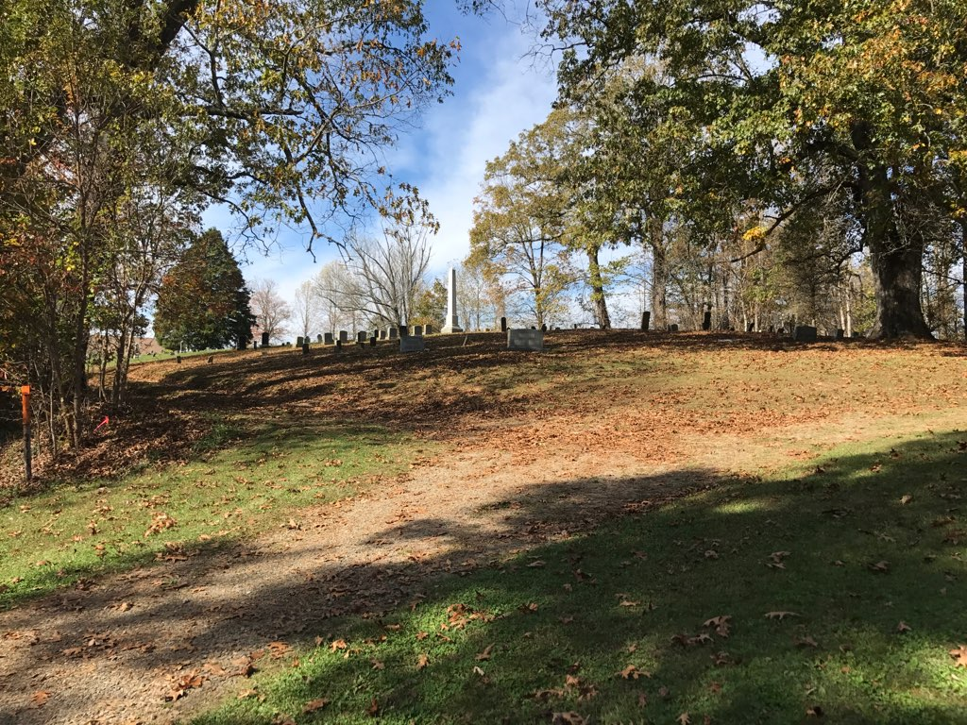
Old Quaker Cemetery, Galax, VA aka Mt. Pleasant Cemetery aka Chestnut Creek Cemetery

Slide 53
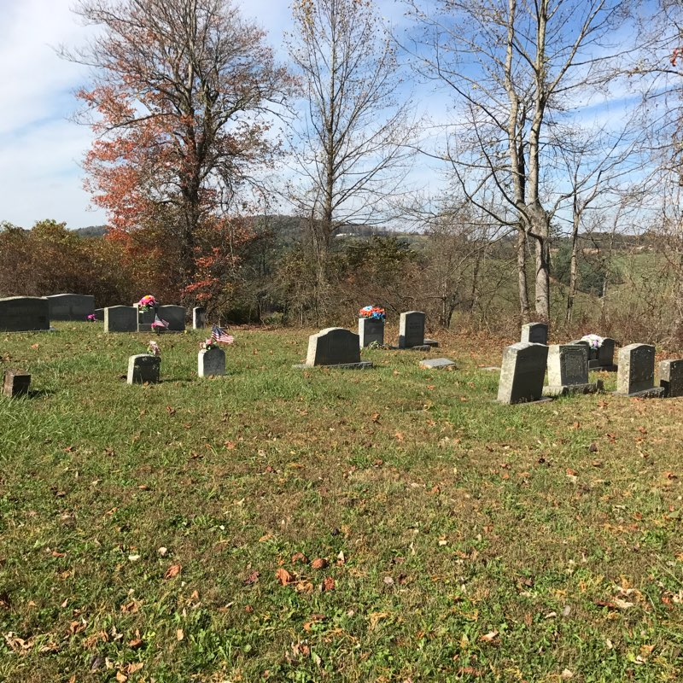
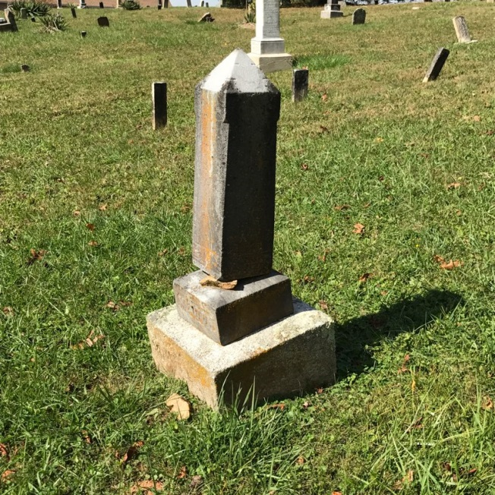
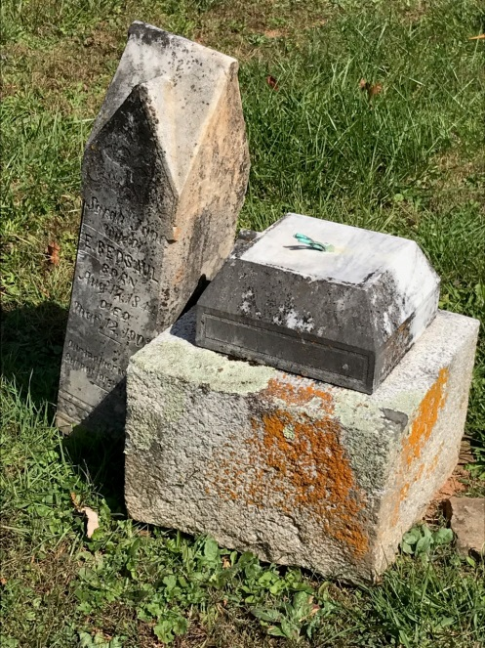
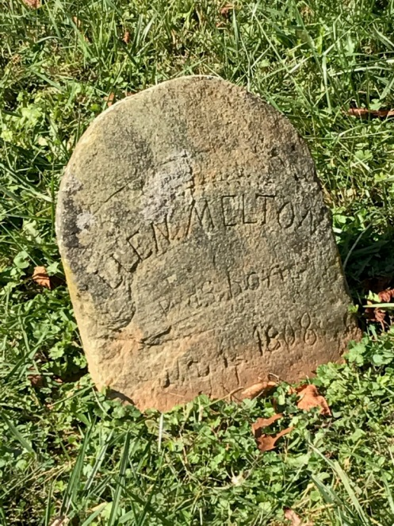
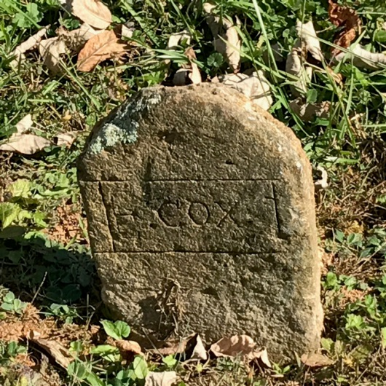
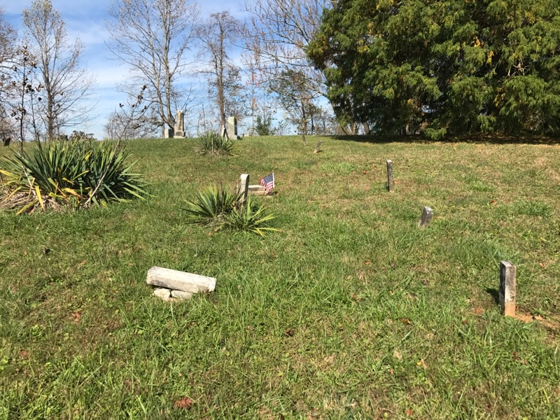
Old Quaker Cemetery
Kk
Completed agreement for Mt. Pleasant Church to assume care of the cemetery in exchange for the deed for their property January 28, 2019
Unique among cemeteries we maintain, there is an active church on the same property. Not connected to NCYM for ~40 years.

Slide 54
Cemeteries Owned/Under the Care of NCYM, Inc.
Bethany (1878; Wayne Co., NC)
Bush River (1770; Newberry, SC)
Dutchman’s Creek (1896; Davie Co., NC)
Hollowell-Massey (1928; Dudley, NC)
Little River (1700; Perquimans Co., NC)
Narrows (1700; Elizabeth City, NC)
Old Quaker Cemetery (1801; Galax, VA)
Pearson-Edgerton (1845; Wayne Co., NC)
Symons Creek (1699; Pasquotank Co., NC)
Woodland (1870; Dudley, NC)

Slide 55
There were questions regarding the possibility that there might be other cemeteries still owned by NCYM, Inc. It was noted that, in addition to reviewing NCYM records of ownership, information prepared by the Quaker Archives (formerly Friends Historical Collection) regarding ownership of Friends cemeteries has also been considered. To the best of our knowledge, the list presented is complete.
Those present approved of accepting the report regarding cemeteries owned/under the care of NCYM, Inc. by NCYM, Inc. Board Clerk, Don Farlow, as presented.

Slide 56
North Carolina Friends Disaster Service, LLC Walter Shore Gary Dodson Allen Gibson NC FDS Co-Coordinators

Slide 57
North Carolina Friends Disaster Service, LLC Purpose
To provide assistance to fellow human beings who are victimized by trouble or disaster as resources are available.

Slide 58
North Carolina Friends Disaster Service, LLC Board Thru 12/31/22
Wiley Shore
Gary Dodson
Charlie Routh
Don Lambe
Dan Allen
Frank Massey
Ex Officio: NCYM, Inc. Clerk and NCYM, Inc. Treasurer or their designees

Slide 59
North Carolina Friends Disaster Service, LLC Officers 12/31/18
Coordinator (Manager) – Wiley Shore
Assistant Coordinator (Assistant Manager) – Gary Dodson
Recording Clerk – Frank Massey
Treasurer - Charles Routh
Assistant Treasurer -

Slide 60
North Carolina Friends Disaster Service, LLC Officers 9/30/19
Co-Coordinators – Walter Shore
Allen Gibson
Gary Dodson
Recording Clerk – Frank Massey
Treasurer - Charles Routh
Assistant Treasurer -

Slide 61
North Carolina Friends Disaster Service, LLC 2018 Fiscal Year
Income: $16,853.50
Expenses: $10,846.45
Operating Account Balance 12/31/18 - $ 22,601.24
Investment Account Balance 6/30/19 - $230,796.08
Operating Account Balance 9/30/19 -- $ 9,216.66
Memorials for Wiley Shore 9/30/19 --- $ 6,061.91

Slide 62
2018 North Carolina Friends Disaster Service, LLC Audit Review The 2018 Friends Disaster Service, LLC audit is incorporated within the NCYM, Inc. portion of the unified audit.

Slide 63
North Carolina Friends Disaster Service, LLC Projects

Slide 64
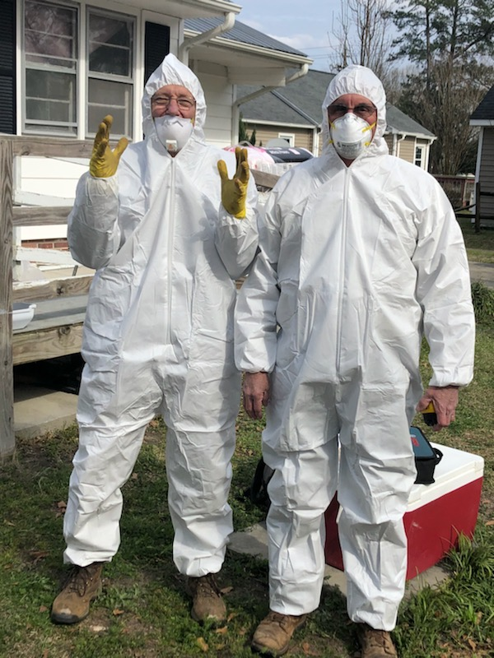
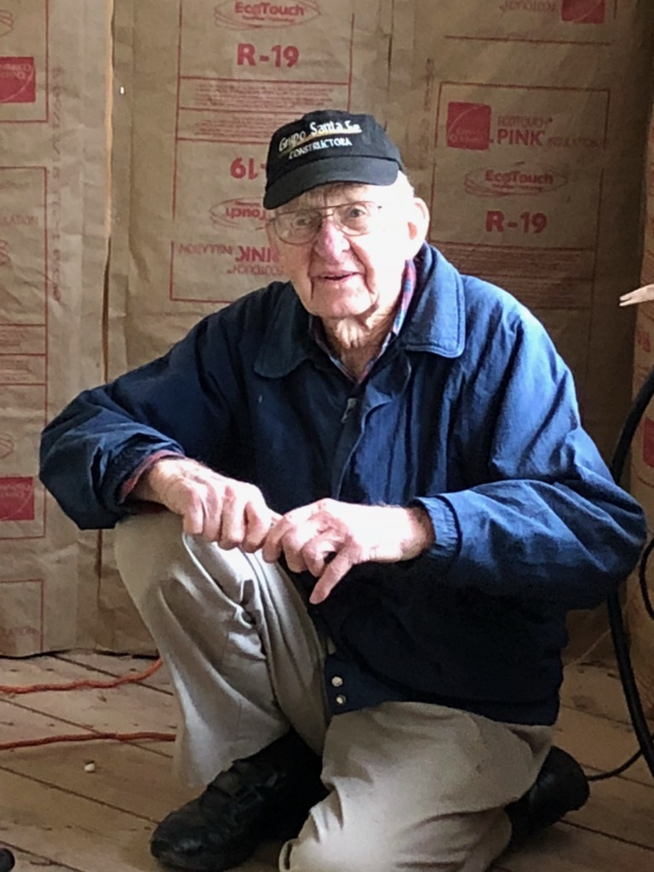
Swansboro – Jacksonville, NC May 2019
Gary Dodson shared regarding the work of NC FDS in 2018 – 2019.

Slide 65
Swansboro – Jacksonville, NC May 2019 Wiley Shore’s final NC FDS project.

Slide 66
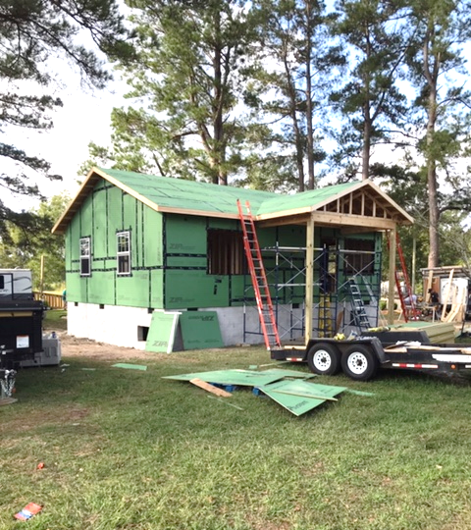
Lake Waccamaw
September 2019
Allen Gibson: “We change lives everywhere we go.”

Slide 67
Those present approved of accepting the report regarding North Carolina Friends Disaster Service, LLC by NC FDS Co-Coordinators, Walter Shore, Gary Dodson and Allen Gibson as presented.

Slide 68
NCYM Funds, LLC (Trustees of Trust Funds) Dick Coe NCYM Funds Secretary / Treasurer

Slide 69
NCYM Funds, LLC Purpose
The purpose of the Trustees of Trust Funds is to hold in trust those funds entrusted to NCYM, Inc. and to invest those funds in a prudent manner structured to provide the highest return consistent with safety of principal and the stated purpose of the fund.

Slide 70
NCYM Funds, LLC Trustees 2018 - 2022
Richard Coe
David Edgerton
Quinn Jordan
Deets McCullen
Carl Semmler
Wilson Sheldon
Tom Wright
Ex Officio: NCYM, Inc. Financial Manager; NCYM, Inc. Clerk; NCYM, Inc. Treasurer
The NCYM Funds Trustees will return to a seven year rotation in 2022.

Slide 71
2019 NCYM Funds, LLC Officers
Chair - David Edgerton
Secretary/Treasurer - Richard Coe
Assistant Secretary/Treasurer - Carl Semmler

Slide 72
NCYM Funds, LLC 2018 Fiscal Year Audit
NCYM Funds, LLC 2018 Fiscal Year – April 1, 2018 through December 31, 2018
The fiscal year for NCYM Funds, LLC has been modified to be consistent with the NCYM, Inc. fiscal year effective January 1, 2019.
All audits conducted by the same certified public accountants/auditing firm.

Slide 73
Auditor’s Opinion NCYM Funds, LLC 2018 Fiscal Year Audit
“In our opinion, the financial statements referred to above present fairly, in all material aspects, the assets, liabilities, and net assets of NCYM Funds, LLC as of December 31, 2018, and the related statements of changes in fund balances for the year then ended, ….”
Councilman, Farlow, Marlowe and Company
Certified Public Accountants and Advisors

Slide 74
2018 NCYM Funds, LLC Audit Review
Recommendation 1. “The Business Manager records transactions and reconciles bank statements. A basic premise of internal control is that no one employee should have access to all phases of a transaction. The organization already segregates the check signing function from the recording function. Unfortunately, due to the limited size of the organization, it is necessary that the Business Manager reconcile the bank accounts to the general ledger. But, it would be a good internal control procedure for someone else, probably the Treasurer, to obtain the bank statement unopened and to review the deposits and checks clearing the bank statement. Someone should also review the monthly reconciliation and general ledger detail for overall reasonableness.”

Slide 75
2018 NCYM Funds, LLC Audit Review
Recommendation 1 (cont.). “We have observed no unusual activity in this area, but do note that the review of the bank statement and reconciliation by the Treasurer and the review of the general ledger detail on a monthly basis would add additional internal control to the process.”
Response: The Treasurer of NCYM Funds, LLC can access the bank statement and the TD Ameritrade accounts online and the Treasurer and the Financial Manager regularly reconcile these accounts.

Slide 76
2018 NCYM Funds, LLC Audit Review
Recommendation 2. After the Organization’s name change as of January 1, 2018, the financial institutions have not been updated as to the current name (North Carolina Yearly Meeting of the Religious Society of Friends, Inc. [NCYM, Inc.]). This could create potential for errors in reporting. There were no observed errors during this audit, but it is something that should be corrected going forward.
Response: With numerous transactions required to transition and consolidate funds, the name change was delayed to avoid reporting errors. With these transitions and consolidations completed, the name change was concluded with our investment firm, TD Ameritrade, prior to December 31, 2018.

Slide 77
Additions to General Trust Fund 2018 FY* (April 1, 2018 – December 31, 2018)
Dr. J. R. Williams grant refunds ------------------------ $ 19,316.69
SGFM property proceeds -------------------------------- $ 831,951.00
Cemetery Fund (Hollowell-Massey) ------------------- $ 1,590.50
Other ----------------------------------------------------------- $ 1,030.00
*Only nine months due to changing the NCYM Funds, LLC fiscal year to coincide with the NCYM, Inc. fiscal year [calendar year])

Slide 78
General Trust Fund 2018FY Investment Performance (April 1, 2018 – December 31, 2018)
NCYM General Trust Fund Gain – 6.1%
S&P Index Gain – <5.1%>
Note that approximately 25% of the General Trust Fund, per previous instruction of NCYM Representative Body, is invested in bonds, bond equivalents or other “fixed” income investments typically yielding lower returns.

Slide 79
General Trust Fund Association Payout 2018, 2019, 2020
2018 - $145,783
2019 - $161,106 (10.5% increase)
2020 - $180,007 (11.7% increase)
2021 – Payout will benefit from income from the sale of the Spring Garden Friends Meeting property and the balance of the “Transition Fund”

Slide 80
2019 General Trust Fund Income Payout
Total Payout to FCNC/NCFF - $161,106*
Church Extension - $65,282*
Missions - $47,307*
Undesignated - $27,054*
Ministerial Education and Training - $13,640*
Other (C.E., E&O, Pub., Young Friends) - $7,823*
Quaker Lake Camp, LLC - $80,000
“Third-Party” - $36,231
Total Distribution - $277,337
General Trust Fund Market Value 3/31/18 - $7,563,958
*Paid proportionately to the two associations (24.4%-75.6%; NCFF - $39,310;
FCNC - $121,796); 83% of funds expenditure restricted by covenants/donor wishes

Slide 81
2020 General Trust Fund Income Payout
Total Payout to FCNC/NCFF - $180,007*
Church Extension - $70,165*
Missions - $50,846*
Undesignated - $35,928*
Ministerial Education and Training - $14,660*
Other (C.E., E&O, Pub., Young Friends) - $8,408*
Quaker Lake Camp, LLC - $80,000
“Third-Party” - $38,901
Total Distribution - $298,908
General Trust Fund Market Value 6/30/19 - $9,088,204
*Paid proportionately to the two associations (24.4%-75.6%; NCFF - $43,922;
FCNC - $136,085); 80% of funds expenditure restricted by covenants/donor wishes

Slide 82
Unrestricted Investment Accounts 6/30/19*
Quaker Lake Development (Ross and Murchison) ------ $191,010
MOWA Choctaw Friends Center (9/30/19)--------------- $ 35,645
Friends Disaster Service (FDS GIA and Maxton Stout) - $230,796
*Accessible as needed

Slide 83
A question was asked regarding the resolution of funds remaining from the MOWA Choctaw Investment Account. The response was that the remainder of these funds, after all accounts were settled, would be provided to The Friends Center, Inc.

Slide 84
Emmett C. Edgerton Fund
Beneficiaries
Salvation Army (31.1%)
Bethesda Friends Meeting (23.3%)
American Friends Service Committee (15.6%)
Retained Earnings (30.0%)
Annual payout equivalent to net yearly income. “Aged Ministers” portion of Edgerton Fund was utilized with other retirement funds for the NCYM Pension Plan buyout.
Market Value 12/31/18 - $1,261,759.27

Slide 85
NCYM Funds, LLC Conformance to Operating Agreement
Per the stated purpose of the Trustees of Trust Funds, funds entrusted to NCYM, Inc. have been held in trust, invested in a prudent manner structured to provide the highest return consistent with safety of principal, and income specified for the stated purpose of the funds.
Activities have been consistent with those permitted by a non-profit organization with tax-exempt status under Section 501(c)(3) of the IRS Code.
There have been no activities related to propaganda, political campaigns or influencing legislation.
No part of the net earnings of NCYM Funds, LLC have benefitted the Trustees /Officers of NCYM Funds, LLC.

Slide 86
Those present approved of accepting the report regarding NCYM Funds, LLC by NCYM Funds Treasurer, Dick Coe, as presented.

Slide 87
Quaker Lake Camp, LLC Tyler Surratt, Chair Heather Varner, Executive Director Joyce Wolford, QLC Foundation

Slide 88
Quaker Lake Camp, LLC Board 2018 - 2022
Laura Altizer
Martha Farlow
Grimsley Hobbs
Tommy Hylton
Beth Joyce
Rita Mintmier
Jay Osborne
David Robinette, Sr.
Tyler Surratt
Joyce Wolford
Brian Wooten
Ex Officio: QLC, LLC Exec. Director, NCYM, Inc. Clerk; NCYM, Inc. Treasurer
It was noted that Grimsley Hobbs has resigned from the QLC Board, that a vacancy policy has been developed, and a replacement from North Carolina Fellowship of Friends will be named.

Slide 89
Quaker Lake Camp, LLC Board Officers
Chair – Tyler Surratt
Recording Clerk – Martha Farlow
Treasurer – Joyce Wolford
Assistant Treasurer – Rita Mintmier

Slide 90
Quaker Lake Camp Purpose
The overall objective for Quaker Lake Camp is for each camper to experience growth of the total person within the context of the Christian Faith as experienced by the Religious Society of Friends (Quakers) through participation in all phases of the camping program -- worship, study, work and play.

Slide 91
Quaker Lake Camp, LLC 2018 Budget
Expenses - ~$488K
Income - ~$488K
Fees, rentals and contributions - ~$306K
Association designated TF income - $80K*
Association Askings/commitment - $80K*
Donor designated TF income - $22K
* Budgeted Association support through designated TF income and financial commitment (Askings) – 32.8%

Slide 92
Quaker Lake Camp, LLC 2018 Income
Income - $519,719.17
Camper Fees - $213,028.50
Association designated TF income - $80,000.00
Association Askings/commitment - $80,000.00
Year-Round programming - $42,237.60
Rentals - $41,996.50
Contributions (including “camperships”) - $13,135.00
Donor designated TF income - $21,770.64
Capital Project income - $21,655.81
Sales and Miscellaneous - $5,895.12

Slide 93
Quaker Lake Camp, LLC 2018 Conformance to Operating/Lease Agreements
Per the stated purpose of Quaker Lake Camp, ….
Activities have been consistent with those permitted by a non-profit organization with tax-exempt status under Section 501(c)(3) of the IRS Code.
There have been no activities related to propaganda, political campaigns or influencing legislation.
No part of the net earnings of Quaker Lake Camp, LLC have benefitted the Trustees /Officers of Quaker Lake Camp, LLC.
Maintenance of American Camping Association Certification
Utilization of QLC facility for the NCYM, Inc. Annual Meeting
Budget performance was slightly under 1% unfavorable, …

Slide 94
Quaker Lake Camp, LLC 2018 Conformance to Operating Agreement
2018 QUAKER LAKE BUDGET QUARTERLY SUMMARY*
 | QUARTER 1 | QUARTER 2** | QUARTER 3 | QUARTER 4 | TOTAL
INCOME:
Budgeted $ | $114,436.00 | $168,700.00 | $127,235.00 | $77,650.00 | $488,021.00
% of Total Budget | 23.0% | 35.0% | 26.0% | 16.0% | 100.0%
Actual $ | $135,054.33 | $192,835.50 | $121,073.99 | $70,755.35 | $519,719.17
Actual % of Budget | 27.7% | 39.5% | 24.8% | 14.5% | 106.5%
Budgeted Cumulative Total | $114,436.00 | $283,136.00 | $410,371.00 | $488,021.00
Actual Cumulative Total | $135,054.33 | $327,889.83 | $448,963.82 | $519,719.17
Actual Cumulative % of Budget | 27.7% | 67.2% | 92.0% | 106.5%

Slide 95
Quaker Lake Camp, LLC 2018 Conformance to Operating Agreement
2018 QUAKER LAKE BUDGET QUARTERLY SUMMARY*
EXPENSES: | QUARTER 1 | QUARTER 2** | QUARTER 3 | QUARTER 4 | TOTAL
Budgeted $ | $87,056.00 | $155,556.00 | $165,139.00 | $80,270.00 | $488,021.00
% of Total Budget | 17.8% | 31.9% | 33.8% | 16.4% | 100.0%
Actual $ | $69,236.05 | $149,937.43 | $ 216,092.43 | $89,208.35 | $524,474.26
Actual % of Budget | 14.2% | 30.7% | 44.3% | 18.3% | 107.5%
Budgeted Cumulative Total | $87,056.00 | $242,612.00 | $407,751.00 | $488,021.00
Actual Cumulative Total | $69,236.05 | $219,173.48 | $435,265.91 | $524,474.26
Actual Cumulative % of Budget | 14.2% | 44.9% | 89.2% | 107.5%

Slide 96
Quaker Lake Camp, LLC 2018 Conformance to Operating Agreement
2018 QUAKER LAKE BUDGET QUARTERLY SUMMARY*
 | QUARTER 1 | QUARTER 2** | QUARTER 3 | QUARTER 4
PROJECTED CUMULATIVE NET | $27,380.00 | $40,524.00 | $2,620.00 | $0.00
ACTUAL CUMULATIVE NET | $65,818.28 | $108,716.35 | $13,697.91 | -$4,755.09
*For future unexpected unfavorable variances, the QLC Board would access the "Balance Brought Forward" from 2018 ($40,366.04)

Slide 97
Quaker Lake Camp, LLC Conformance to Covenants/Donor Wishes for Expenditure of Trust Fund Income 2018
Campership Funds - $4,881
----
Development Funds - $6,292
----
Operating Funds - $10,598
----

Slide 98
2018 Quaker Lake Camp, LLC Audit Review
The 2018 Quaker Lake Camp, LLC audit is incorporated within the NCYM, Inc. unified audit.

Slide 99
Quaker Lake Camp Foundation
Joyce Wolford, Director of the QLC Foundation, shared that the Foundation has been confirmed as a 501(c)(3) and received their North Carolina solicitation license. The Foundation’s primary purpose is to build an endowment for the support of Quaker Lake Camp.

Slide 100
Heather Varner, QLC Executive Director, noted that 2020 marked the 70th anniversary of camping at Quaker Lake Camp and that many special events are being planned.
Those present approved of accepting the report regarding Quaker Lake Camp, LLC and the Quaker Lake Camp Foundation by QLC Chair, Tyler Surratt, QLC Executive Director, Heather Varner, and QLC Foundation Director, Joyce Wolford, as presented.

Slide 101
FCNC
F&P authority
Nom. Comm.
F&P Rev.
Comm. on Clerks
Exec. Comm.
M&C
…
FCNC Askings
NCFF
F&P authority
Nom. Comm.
F&P Rev.
Comm. on Clerks
Exec. Comm.
M&C
…
NCFF Askings
NCYM Inc.
Cemeteries
QLC Land/Buildings
Real Estate/Proceeds (“Funds”)
Financial & Admin Services
24.4% available TF income
75.6% available TF income
NCYM Funds, LLC
TF income
NC FDS, LLC
NCYM/QLC Pledge (75.6%)
NCYM/QLC Pledge
(24.4%)
Quaker Lake Camp, LLC
Operating Agreement
Lease Agreement
Board-Managed Camp
“Structured to maintain current (2017) mission”
QLC Foundation
Funding

Slide 102
North Carolina Fellowship of Friends Frank Massey NCFF Clerk

Slide 103
North Carolina Fellowship of Friends
Frank Massey, Clerk of NCFF, presented the annual report for:
Report to NCYM, Inc.
2 November 2019

Slide 104
NC Fellowship of Friends Organization
Recording Committee
Meeting Nurture and Development Committee
Social Justice Working Group
Outreach Working Group
Youth & Children Working Group
Faith & Practice Committee (to be reviewed for NCFF approval 11/9/19)
Manual of Procedure (Administration Guidelines)
NCFF gathers in March, August for Annual Session, and November

Slide 105
NC Fellowship of Friends 2018 Trust Fund Income & Expenses
Outreach (income: $10,889)
Jamaica Project $500
“Living Letters” trip to the Palestine/Israel $750
MOWA/Choctaw $2,000
Total Disbursed: $3,250

Slide 106
NC Fellowship of Friends 2018 Trust Fund Income & Expenses
Young Friends Activities (income $71) $1,000
Church Extension (income $14,839) $4,600 grant to Statesville Friends Meeting for refurbishing their meeting house

Slide 107
NCFF Report to NCYM, Inc. On 2019 Activities
Friends United Meeting:
Girl Child Education $1,000
They are shy, here in the head teacher’s office, speaking softly and hesitantly in English—which is, after all, their third language. But they’ve come.
“I like to be at school,” says the first girl, age thirteen, “because at home, when I am not at school, I am cooking and caring for animals and I do not have time to read.”…. Their mothers did not go to school; just ten years ago, here in Loltulelei, Samburu, only two girls graduated from the eighth grade. (Last year, thirty girls did. This primary school is transforming the community.)

Slide 108
NCFF Report to NCYM, Inc. On 2019 Activities
Belize Friends School and Center $1,000
Belize Friends School gives young people in Belize a second chance to succeed at entering High school or Trade school and to be successful in life!
From the U.S. Embassy’s FaceBook post: "Great teachers empathize with kids, respect them, and believe that each one has something special that can be built upon."- Ann Lieberman

Slide 109
NCFF Report to NCYM, Inc. On 2019 Activities
Lugulu Hospital (Kenya) $1,000
Friends Lugulu Mission Hospital was established by Quaker missionaries in 1913. Now a 100-bed hospital, the hospital provides emergency, medical, and surgical services in a densely populated region where such resources are scarce. All patients are welcome, and compassionate care is offered to all patients—including those with HIV/AIDS.
Adopt-a-Bed Program Adopt-a-Bed program covers hospital expenses for individuals who are unable to pay.
HIV/AIDS The Hospital pioneered an award-winning Antiretroviral Therapy (ART) department for HIV/AIDS care—the first of its kind in Western Kenya.
Maternity Care The Hospital delivers over 2,000 newborns each year, taxing its existing childbirth center. A proposed expansion of the maternity ward is planned.

Slide 110
NCFF Report to NCYM, Inc. On 2019 Activities
General Budget $1,000
Mission statement: Friends United Meeting commits itself to energize and equip Friends through the power of the Holy Spirit to gather people into fellowships where Jesus Christ is known, loved, and obeyed as Teacher and Lord.
About FUM: The Friends United Meeting community stretches far and wide across the globe. We are a collection of Christ-centered Quakers, embracing thirty-seven Yearly Meetings and Associations, thousands of local gatherings and hundreds of thousands of individuals…powerfully at work in our local areas and through cross-cultural service.

Slide 111
NCFF Report to NCYM, Inc. On 2019 Activities
Robert Wafula (Friends Theological College, Kenya) $500
Friends Theological College (FTC) is dedicated to the training of Friends pastors, as well as to the academic progress, personal development, and spiritual growth of the students whom God is calling to other ministries.

Slide 112
NCFF Report to NCYM, Inc. On 2019 Activities
Ramallah Friends School (Scholarships) $1,000
The Ramallah Friends School, now celebrating its 150th anniversary since the founding of the Girls School in 1869, now co-ed, the School enrolls 1,400 students in pre-K through 12th grade. The curriculum is International Baccalaureate throughout, and recent initiatives have re-vitalized the School's commitment to Quaker education. Widely regarded as the finest school in Palestine, with a track record of educating leaders of the Palestinian political, religious, and economic society, the School is still challenged by financial constraints. A military occupation severely restricts the economy, making it difficult for families to meet the School's tuition and fees.

Slide 113
NCFF Report to NCYM, Inc. On 2019 Activities
“Living letters” trip to Palestine & Israel $1,000
We are deeply grateful for the financial support given to our annual FUM "Living Letters" service-learning trip to the Ramallah Friends School. With a group of 14, outstripping the School's capacity for housing us all, we had to utilize a nearby hostel for two of our group, adding significantly to the costs of our trip. Other uses of the generous grant went to purchasing equipment and materials for our work projects: spreading three tons of dirt for green space at the Lower School; cleaning the meetinghouse and pruning and trimming the meetinghouse grounds; and cleaning the Upper School's arboretum. Funds also assisted in our being able to include two Guilford students from Ramallah on our trips around the West Bank and Israel.

Slide 114
NCFF Report to NCYM, Inc. On 2019 Activities
AGLI (Africa Great Lakes Initiative) $1,000
The African Great Lakes Initiative (AGLI) strengthens, supports, and promotes peace activities at the grassroots level in the Great Lakes region of Africa (Burundi, Congo, Kenya, Rwanda, Tanzania, and Uganda). AGLI responds to requests from local religious and non-governmental organizations that focus on conflict management, peace building, trauma healing, and reconciliation. AGLI sponsors Peace Teams composed of members from local partners and the international community.

Slide 115
NCFF Report to NCYM, Inc. On 2019 Activities
Fayetteville Quaker House $1,000
Celebrating 50 years of ministry, 1969-2019
Some of our activities over the past year:
Counseling/Support to Service Members and Their Families and Education
Education: GI Rights Hotline (Worldwide)
Domestic Violence, Sexual Assault, and Moral Injury Counseling (North Carolina)
National and Local Advocacy for a More Peaceful World
Advocacy Team (Federal Level)
Commission Watch (National Advocacy)
Conscientious Objection (Education, US-Based Assistance)

Slide 116
NCFF Report to NCYM, Inc. On 2019 Activities
MOWA-Choctaw $500
Worthington Friends Church, Kingston, Jamaica $500
Since 1963 Friends in Jamaica and Friends in the US have joined in ministry in a variety of ways, changing to match changing needs there with resources available locally and from the U.S. through Friends United Meeting. Currently, David Goode serves as pastor of Worthington Friends Church in Kingston. As pastor, he also facilitates various other local ministries and hosts mission teams from the U.S.

Slide 117
NCFF Report to NCYM, Inc. On 2019 Activities
ECAR (Every Campus a Refuge) $500
Every Campus A Refuge (ECAR) was founded in 2015 as a response to Pope Francis' call on every parish to host one refugee family. We are a non-profit program that provides best practices on how colleges and universities around the globe can become a refuge by following our process of hosting refugees on campus grounds and assisting them in resettlement.
At Guilford College, where the initiative was born, we temporarily host refugees in a permanent residence dedicated to ECAR. Guilford has thus far hosted 32 refugees, 18 of them children.

Slide 118
NCFF Report to NCYM, Inc. On 2019 Activities
AFSC Immigration work $1,000
Friends Committee on National Legislation (Care for the environment) $1,000
Friends Emergency Materials Assistance Program $500
Friends World Committee for Consultation $1,000
NC Council of Churches $1,000
…They also are taking the lead with the NC No Torture campaign to lift awareness of our state’s use of public resources in the CIA’s program of Rendition, Detention, and Interrogation…NC Interfaith Power and Light is the only NC based statewide organization that works on addressing the ecological and justice issues of climate change as a faith-based initiative…
Total Disbursed $14,500

Slide 119
NCFF Report to NCYM, Inc. On 2019 Activities
Church Extension: Income ($17,000)
Miami Friends Meeting: $4,430 (Miami continues in the same physical location with funds contributed for needed repairs/renovations)
Bethel Friends (Franklin, VA): $15,000

Slide 120
NCFF Report to NCYM, Inc. Church Extension: Bethel Friends
July 9, 2019 31220 Whistle Stop Drive
Franklin, VA 23321
North Carolina Fellowship of Friends
Dear Friends,
Words do not suffice to express our gratitude for the grant of $15,000 to aid in the exterior renovation of Bethel Friends meeting house. This money combined with the generosity of local f/Friends is making a real difference in the appearance, climate control efficiency, and long-term durability of our place of weekly worship. With your help we have accomplished the following:
Replaced deteriorated boards
Rebuilt two side porches and one rear porch including steps using composite materials
Installed Celect Cellular Composite Siding that closely mimics the original wooden weatherboards and includes a layer of insulation
Had insulation blown into all exterior walls
Had vinyl soffits installed
Had window woodwork wrapped with aluminum coil stock
Had new vinyl shutters installed (still waiting on a few shutters which had to be reordered due to shipping damage)
Work still to be completed includes:
Installing gutters which have been ordered
Glazing and painting window sashes
Painting columns and detailed areas which could not be covered with siding or coil stock
Laying new flooring over existing front porch
Rebuilding front porch steps and railings
Resurfacing and painting foundation walls
Upgrading interior lighting and carpets
Thank you, Friends, for making such a significant contribution to the life of our meeting house.
Respectfully, Amanda W. Munford, Clerk, Bethel Friends Meeting
(Additional comments regarding engagement of Bethel youth and the support of the Bethel community)

Slide 121
NCFF Report to NCYM, Inc. On 2019 Activities: Bethel Friends

Slide 122
NCFF Report to NCYM, Inc. On 2019 Activities: Bethel Friends

Slide 123
NCFF Report to NCYM, Inc. On 2019 Activities: Bethel Friends

Slide 124
NCFF Report to NCYM, Inc. On 2019 Activities: Bethel Friends

Slide 125
North Carolina Fellowship of Friends 2018 Audit
The 2018 North Carolina Fellowship of Friends audit is incorporated within the NCYM, Inc. unified audit.

Slide 126
Those present approved of accepting the report regarding North Carolina Fellowship of Friends by NCFF Clerk, Frank Massey, as presented.
The affirmation of compliance with the covenants and guidelines for the expenditure of trust fund income, signed by the Association’s Presiding Clerk and Treasurer, is included in “Word” documents transmitted separately.

Slide 127
Friends Church of North Carolina Roger Greene FCNC Clerk

Slide 128
Friends Church of North Carolina 2018 Audit
The 2018 Friends Church of North Carolina audit is incorporated within the NCYM, Inc. unified audit.

Slide 129
See the “Word” documents (from November 2018 and November 2019), transmitted separately, for the report of Roger Greene, Clerk of North Carolina Fellowship of Friends.

Slide 130
Those present approved of accepting the report regarding Friends Church of North Carolina by FCNC Clerk, Roger Greene, as presented.
The affirmation of compliance with the covenants and guidelines for the expenditure of trust fund income, signed by the Association’s Presiding Clerk and Treasurer, is included in “Word” documents transmitted separately.

Slide 131
NCYM, Inc.
2020 Annual Meeting
November 7, 2020

